Slide 1


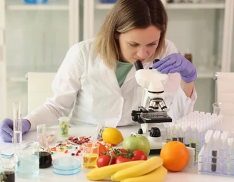
FOOD QUALITY ASSESSMENT USING IMAGE PROCESSING
1

Slide 2
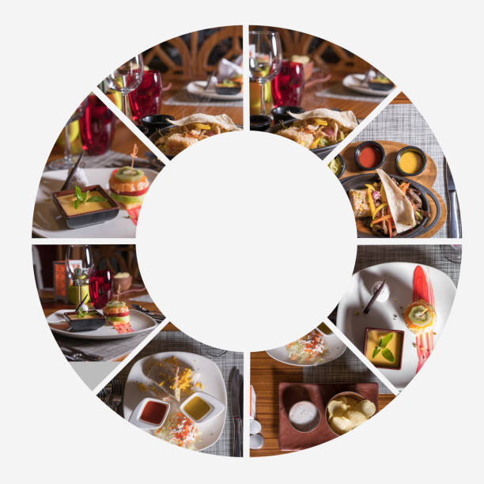

PROBLEM STATEMENT
Traditional methods of checking food quality are manual, slow, and often inaccurate, leading to food waste and health risks. People find it difficult to track food freshness, especially in households. A smart refrigerator with AI and image processing can help by automatically detecting food spoilage, monitoring freshness, and sending timely alerts. This will improve food management, reduce waste, and enhance food safety.
2

Slide 3
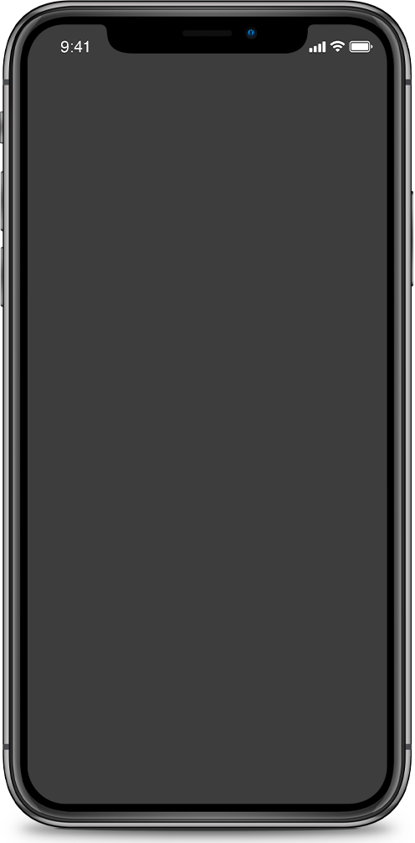
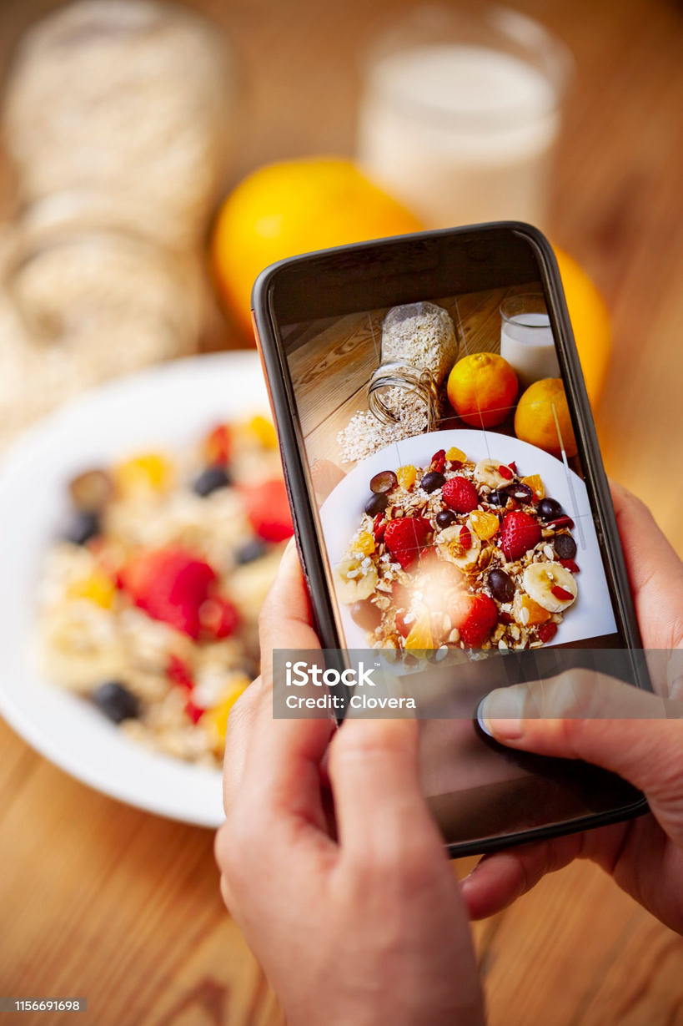
INTRODUCTION
In today’s world, ensuring food quality is more important than ever. Traditional methods of food inspection are often slow, costly, and prone to errors. Image processing offers a modern solution, enabling quick and accurate assessment of food quality through digital images. By analyzing color, texture, shape, and other visual features, it helps detect freshness, contamination, or defects in food products. This technology not only improves food safety but also enhances efficiency in production and distribution. As advancements continue, image processing is becoming a key tool in ensuring safer and higher-quality food.
3

Slide 4
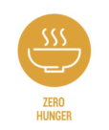



SUSTAINABLE DEVELOPMENT GOALS
2.ZERO HUNGER
3.GOOD HEALTH AND WELL-BEING
Helps reduce food waste and ensures better food availability.
Improves food safety by detecting spoiled or contaminated food.
9.INDUSTRY,INNOVATION AND INFRASTRUCTURE
12.RESPONSIBLE CONSUMPTION AND PRODUCTION
Uses AI and technology to make food inspection faster and more efficient.
Reduces waste by identifying food quality accurately.
4

Slide 5

DATASET
The *Food 41* dataset contains images of 41 different types of food, with a total of around 41,000 images. Each food item is categorized into one of the 41 classes, such as pizza, sushi, or pasta. The images are collected from various sources and cover a wide range of food items, helping to train models for food recognition and classification tasks. This dataset is useful for developing machine learning models to identify and classify food based on their visual appearance, making it valuable for applications in automated food recognition systems.
link:https://www.kaggle.com/datasets/kmader/food41?select=images
5

Slide 6
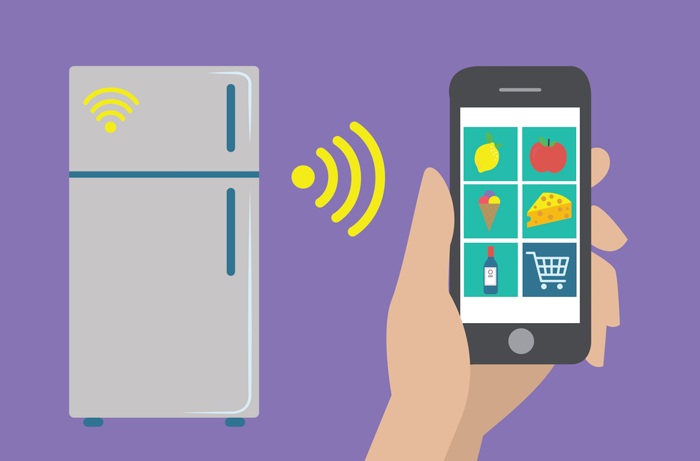
CONCLUSION:
The smart refrigerator system can send real-time notifications to users.
It helps buy scarce food items from nearby online or offline sellers.
An Android app provides updates and important information about the fridge’s operation.
The system uses an Android OS to send surveys based on the available fruits and vegetables.
Machine learning helps check the condition of stored food items.
It is useful for users who are away from home and need updates on stored food.
Smart freezers with these features will be important in future smart homes.
The system alerts users about fridge contents more accurately.
6

Slide 7

THANK
YOU
7

